Slide 1

TOPIC:
Computer Organization and Architecture
Basic Computer Organization: Instruction Codes, Computer Registers, Computer Instructions
(Lectures 7-9)

Slide 2
INTRODUCTION
Every different processor type has its own design (different registers, buses, micro-operations, machine instructions, etc.)‏
Modern processor is a very complex device
It contains
Many registers
Multiple arithmetic units, for both integer and floating point calculations
The ability to pipeline several consecutive instructions to speed execution
Etc.
However, to understand how processors work, we will start with a simplified processor model
This is similar to what real processors were like ~25 years ago
M. Morris Mano introduces a simple processor model he calls the Basic Computer

Slide 3
THE BASIC COMPUTER
The Basic Computer has two components, a processor and memory
The memory has 4096 words in it
4096 = 2¹², so it takes 12 bits to select a word in memory
Each word is 16 bits long
CPU
Instruction Format
Program
A sequence of (machine) instructions
(Machine) Instruction
A group of bits that tell the computer to perform a specific operation (a sequence of micro-operation)
0
15
0
4095

Slide 4
Instruction Codes

Slide 5
Instruction Codes
The organization of the computer is defined by its internal registers, the timing and control structure, and the set of instructions that it uses.
A computer instruction is a binary code that specifies a sequence of micro-operations for the computer.
An instruction code is a group of bits that instruct the computer to perform a specific operation.
Instruction code is usually divided into two parts.
Operation part - Group of bits that define such operations as add, subtract, multiply, shift, and complement.
Address part - Contains registers or memory words where the address of operand is found or the result is to be stored.
Each computer has its own instruction code format.

Slide 6
Operation Code
The operation code (op-code) of an instruction is a group of bits that define such operations as add, subtract, multiply, shift, and complement.
The number of bits required for the operation code of an instruction depends on the total number of operations available in the computer (n bits for 2^{n} operations).
Instruction Format
15
14
12
11
0
I
Opcode
Address
Addressing
mode

Slide 7
Stored Program Organization
Simplest way to organize computer is to have one processor register(Accumulator AC) and an instruction code format with two parts:
First-Operation to be performed
Second – Address
The memory address tells the control where to find an operand in memory.
This operand is read from memory and used as the data to be operated on together with the data stored in the processor register.

Slide 8
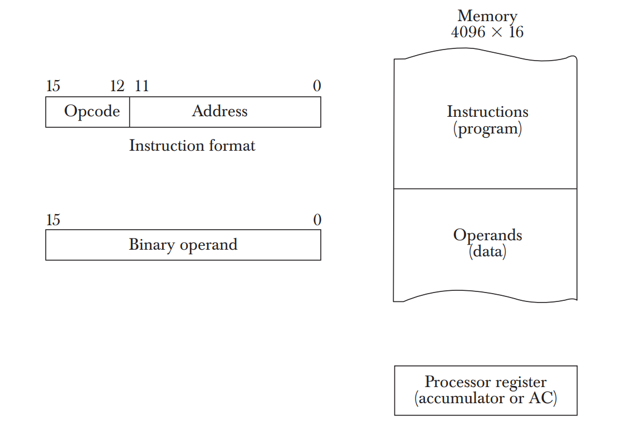
Stored Program Organization
Instructions are stored in one section of the memory and data in another.
For a memory unit with 4096 words we need 12 bits to specify an address since 2¹²=4096.
4 bits are available for opcode to specify one out of 16 possible operations.

Slide 9
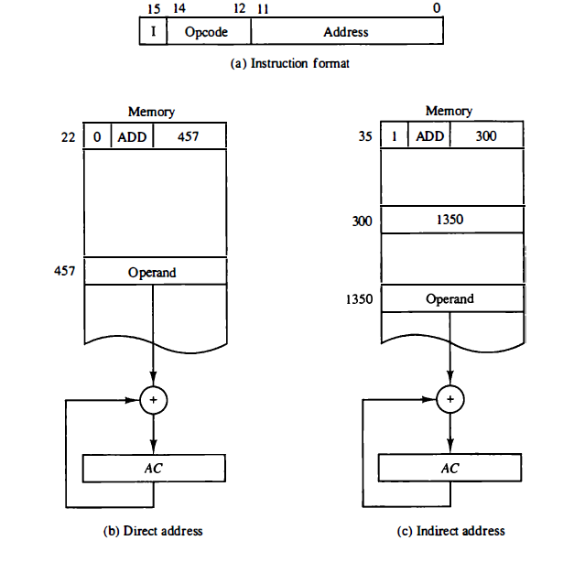
Direct and Indirect Addressing Modes
Following Addressing Modes are used for address portion of the instruction code.
Direct- The address part specifies the address of an operand.
Indirect- The address part specifies a pointer(another address) where the address of the operand can be found.
One bit of the instruction code(I) can be used to distinguish between a direct and an indirect address.

Slide 10
Steps
The control unit reads a 16-bit instruction from the program portion of memory.
It uses the 12-bit address part of the instruction to read a 16-bit operand from the data portion of memory.
It then executes the operation specified by the operation code.
The operation is performed with the memory operand and the content of AC.

Slide 11
Effective Address
It is the address of the operand in a computation-type instruction or the target address in a branch-type instruction.
The effective address in the instruction of the figures are 457 and 1350.

Slide 12
Computer Registers

Slide 13
Computer Registers
Need of Registers?
Computer instructions are normally stored in consecutive memory locations and are executed sequentially one at a time.
The control unit reads an instruction from a specific address in memory and executes it. It then continues by reading the next instruction in sequence and executes it, and so on.
This type of instruction sequencing needs a counter to calculate the address of the next instruction after execution of the current instruction is completed.
It is also necessary to provide a register in the control unit for storing the instruction code after it is read from memory.
The computer needs processor registers for manipulating data and a register for holding a memory address.

Slide 14
PROCESSOR REGISTERS
Instruction codes
A processor has many registers to hold instructions, addresses, data, etc
The processor has a register, the Program Counter (PC) that holds the memory address of the next instruction to get
Since the memory in the Basic Computer only has 4096 locations, the PC only needs 12 bits
In a direct or indirect addressing, the processor needs to keep track of what locations in memory it is addressing: The Address Register (AR) is used for this
The AR is a 12 bit register in the Basic Computer
When an operand is found, using either direct or indirect addressing, it is placed in the Data Register (DR). The processor then uses this value as data for its operation
The Basic Computer has a single general purpose register – the Accumulator (AC)‏

Slide 15
PROCESSOR REGISTERS
Instruction codes
The significance of a general purpose register is that it can be referred to in instructions
e.g. load AC with the contents of a specific memory location; store the contents of AC into a specified memory location
Often a processor will need a scratch register to store intermediate results or other temporary data; in the Basic Computer this is the Temporary Register (TR)‏
The Basic Computer uses a very simple model of input/output (I/O) operations
Input devices are considered to send 8 bits of character data to the processor
The processor can send 8 bits of character data to output devices
The Input Register (INPR) holds an 8 bit character gotten from an input device
The Output Register (OUTR) holds an 8 bit character to be send to an output device

Slide 16
BASIC COMPUTER REGISTERS
Registers
Registers in the Basic Computer
11
0
PC
Memory
11
0
4096 x 16
AR
15
0
IR
CPU
15
0
15
0
TR
DR
7
0
7
0
15
0
OUTR
INPR
AC
List of BC Registers
DR 16 Data Register Holds memory operand
AR 12 Address Register Holds address for memory
AC 16 Accumulator Processor register
IR 16 Instruction Register Holds instruction code
PC 12 Program Counter Holds address of instruction
TR 16 Temporary Register Holds temporary data
INPR 8 Input Register Holds input character
OUTR 8 Output Register Holds output character

Slide 17
Common Bus System
Need of Common Bus System ?
The basic computer has eight registers, a memory unit, and a control unit.
Paths must be provided to transfer information from one register to another and between memory and registers.
The number of wires will be excessive if connections are made between the outputs of each register and the inputs of the other registers.
Hence more efficient scheme with a common bus is used.

Slide 18
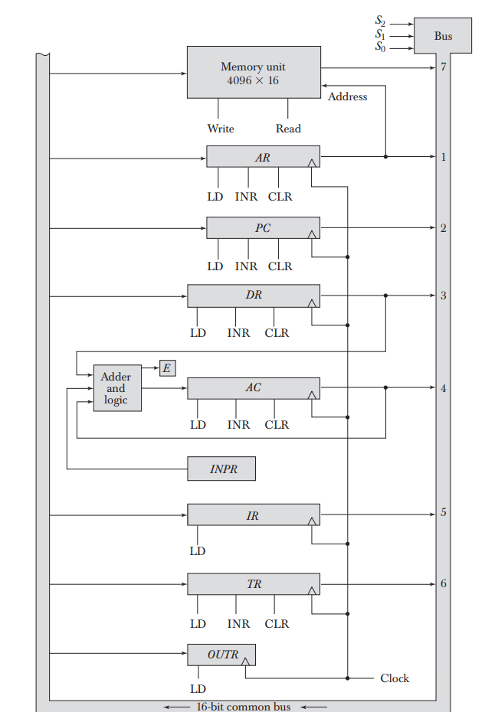
Common Bus System
The outputs of Eight registers and memory are connected to the common bus.
The specific output that is selected for the bus lines at any given time is determined from the binary value of the selection variables S₂, S₁, and S₀.
The number along each output shows the decimal equivalent of the required binary selection.
For example, the number along the output of DR is 3. The 16-bit outputs of DR are placed on the bus lines when S₂S₁S₀ =011 since this is the binary value of decimal 3.

Slide 19
Common Bus System
The lines from the common bus are connected to the inputs of each register and the data inputs of the memory.
The particular register whose LD (load) input is enabled receives the data from the bus during the next clock pulse transition.
INR stands for increment and CLR stands for clear.
The memory receives the contents of the bus when its write input is activated.
The memory places its 16-bit output onto the bus when the read input is activated and S₂S₁S₀ =111.

Slide 20
Common Bus System
INPR is connected to provide information to the bus but OUTR can only receive information from the bus.
This is because INPR receives a character from an input device which is then transferred to AC.
OUTR receives a character from AC and delivers it to an output device.
There is no transfer from OUTR to any of the other registers.
Adder and Logic is ALU and E is used to store the carry bit.

Slide 21
Common Bus System
The inputs of AC come from an adder and logic circuit.
This circuit has three sets of inputs.
One set of 16-bit inputs come from the outputs of AC. They are used to implement register micro-operations such as complement AC and shift AC.
Another set of 16-bit inputs come from the data register DR. The inputs from DR and AC are used for arithmetic and logic micro-operations.
A third set of 8-bit inputs come from the input register INPR.

Slide 22
Computer Instructions

Slide 23
Instruction Format
The basic computer has three instruction code formats each having 16 bits:
Memory reference instructions
Register reference instructions
I/O instructions
The opcode part of the instruction contains three bits and the meaning of the remaining 13 bits depends on the operation code encountered.

Slide 24

Memory Reference Instructions
Bits 0-11 for specifying address.
Bits 12-14 for Opcode.
15th bit specifies addressing modes. (0 for direct and 1 for indirect)

Slide 25

Register Reference Instructions
Recognized by the operation code 111 with a 0 in the 15th bit of the instruction.
Specifies an operation on or a test of the AC register.
An operand from memory is not needed.
Therefore the 12 bits are used to specify the operation to be executed.
Eg:
CLA - 7800 : Clear AC
CLE - 7400 : Clear E

Slide 26

Input-Output Instructions
These instructions are needed for transferring information to and from AC register.
Recognized by the opcode 111 and a 1 in the 15th bit.
Bits 0-11 specify the type of I/O Operation performed.
Eg:
INP - F800 : Input characters to AC
OUT - F400 : Output characters from AC

Slide 27
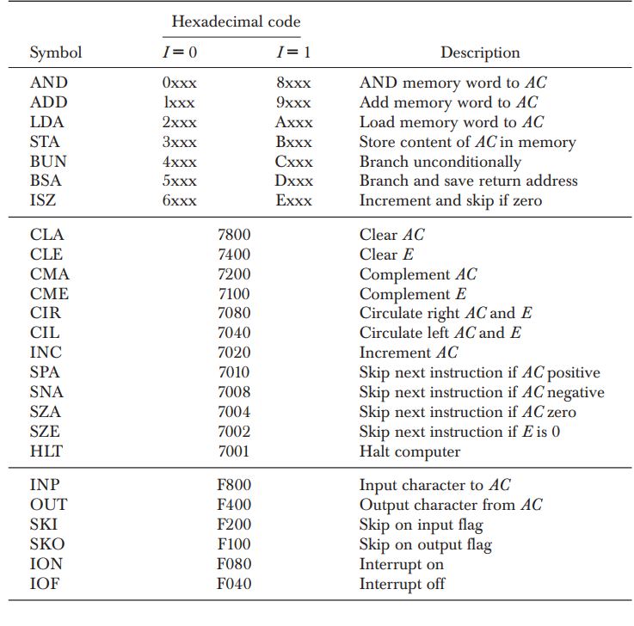
Basic Computer Instructions

Slide 28
Instruction Set Completeness
The set of instructions are said to be complete if the computer includes a sufficient number of instructions in each of the following categories:
Arithmetic, logical, and shift instructions.
Instructions for moving information to and from memory and processor registers.
Program control instructions.
Input and output instructions.

Slide 29
Thank You

